Slide 1


AWS Secrets Manager
Securely manage, rotate, and retrieve secrets

Slide 2

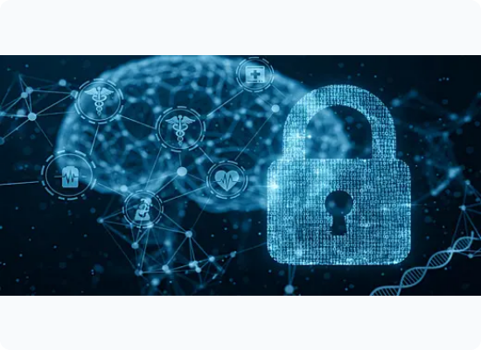
WHAT IS SECRETS MANAGER?
AWS Secrets Manager is a fully managed service that helps you protect secrets needed to access your applications, services, and IT resources.
It allows you to replace hard-coded credentials in your code, including passwords and API keys, with an API call to Secrets Manager to retrieve the secret programmatically.

Slide 3
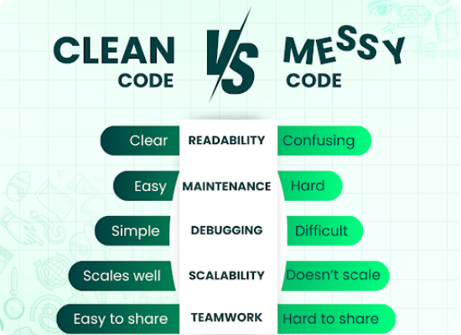
THE PROBLEM: HARD-CODING
Security Risks: Credentials leaked in source code repositories.
Manual Rotations: Updating code every time a password expires.
Lack of Audit: No centralized visibility into who accessed what secret.
Compliance: Failing PCI-DSS or HIPAA requirements for secret age.

Slide 4





CORE SERVICE FEATURES
Auto Rotation
KMS Encryption
Replication
Automatically rotate credentials for RDS, Redshift, and DocumentDB using Lambda.
Secrets are encrypted at rest using AWS KMS keys you control or manage.
Easily replicate secrets across regions for disaster recovery and low latency.

Slide 5
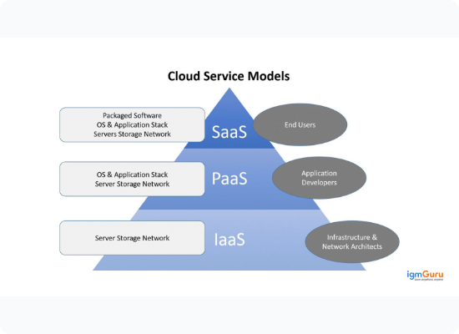
HOW IT WORKS: WORKFLOW
1. Store: Create a secret in the console or CLI.
2. Encrypt: AWS KMS encrypts the secret value.
3. Retrieve: Application requests secret via IAM-authorized API call.
4. Decrypt: Service decrypts and sends value via TLS.

Slide 6





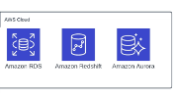
SUPPORTED SECRET TYPES
RDS / Redshift
API Keys
Custom
Full native integration with Amazon RDS instances.
Store OAuth tokens, SaaS keys, or custom binary data.
Arbitrary Key/Value pairs for any application logic.

Slide 7

AUTOMATIC ROTATION
Secrets Manager can rotate credentials on a schedule without user intervention. It uses a Lambda Function to interact with the secret's target resource (e.g., updating a database password).
Benefits: • Reduces risk of long-lived credentials • No application downtime • Complies with security standards

Slide 8
SECRETS MANAGER VS. SSM
Feature | Secrets Manager | SSM Parameter Store
Rotation | Native (Built-in) | Manual/Custom Logic
Cost | $0.40 per secret/month | Free (Standard)
Password Gen | Built-in | No
Cross-Account | Easy integration | Supported but complex

Slide 9
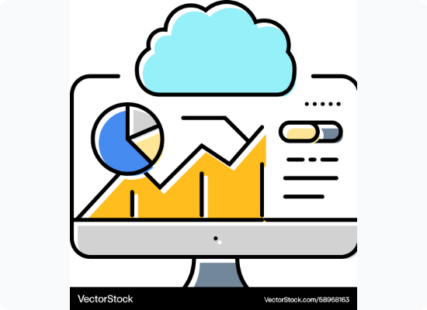
SECURITY & COMPLIANCE
IAM Policies: Granular access control at the secret level.
CloudTrail: Logs all API calls for auditing and compliance.
VPC Endpoints: Access secrets without traversing the internet.
Certifications: HIPAA, PCI, ISO, SOC compliant.

Slide 10

GLOBAL REPLICATION
AWS Secrets Manager supports Multi-Region replication. You can designate a primary region and multiple secondary regions.
•
Enables disaster recovery.
•
Local retrieval for multi-region apps.
•
AWS handles the syncing of values.

Slide 11




IMPLEMENTATION STEPS
Define
Configure
Rotation
Fetch
Choose secret type (RDS vs Other).
Input keys/values and select KMS key.
Set schedule and Lambda logic.
Update app with Secret ARN.

Slide 12
PRICING MODEL
$0.40
API Calls: $0.05 per 10,000 API calls.
Rotation: Standard Lambda costs apply.
Free Tier: 30-day free trial for new users.
Per Secret / Month

Slide 13
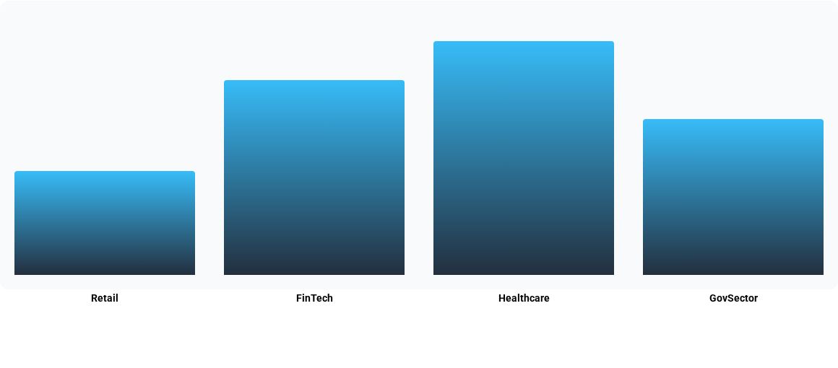
INDUSTRY ADOPTION TRENDS
Adoption rate by sector (Illustrative data based on compliance requirements)

Slide 14



PRO-TIPS & BEST PRACTICES
Least Privilege
Caching
Monitor
Restrict access to specific Secret ARNs in IAM.
Use Client-side caching to reduce costs and latency.
Set CloudWatch Alarms for unexpected deletions.

Slide 15

Any Questions?
Thank you for your time!

Slide 16






IMAGE SOURCES
https://media2.dev.to/dynamic/image/width=1000,height=420,fit=cover,gravity=auto,format=auto/https%3A%2F%2Fdev-to-uploads.s3.amazonaws.com%2Fuploads%2Farticles%2Faq5dgso20q9e2kdxrisn.png
Source: dev.to
https://png.pngtree.com/thumb_back/fh260/background/20260304/pngtree-digital-lock-on-cyber-network-system-image_21511146.webp
Source: pngtree.com
https://techglide.in/wp-content/uploads/2024/09/clean-vs-messy-code.png
Source: techglide.in
https://cdn.shopaccino.com/igmguru/images/cloud-computing-services-model-3624666283012684.jpg
Source: www.igmguru.com
https://media2.dev.to/dynamic/image/width=1280,height=720,fit=cover,gravity=auto,format=auto/https%3A%2F%2Fdev-to-uploads.s3.amazonaws.com%2Fuploads%2Farticles%2F3tgzgbnrbpf33nfnn1t6.png
Source: dev.to
https://png.pngtree.com/png-clipart/20250417/original/pngtree-digital-security-concept-with-shield-and-chip-for-protecting-financial-transactions-png-image_20715100.png
Source: pngtree.com

Slide 17



IMAGE SOURCES
https://cdn.vectorstock.com/i/1000v/81/63/cloud-monitoring-dashboard-icon-vector-58968163.jpg
Source: www.vectorstock.com
https://static.vecteezy.com/system/resources/thumbnails/070/780/168/small/digital-blue-world-map-with-glowing-connection-points-and-network-lines-modern-concept-design-representing-global-communication-internet-technology-and-worldwide-connectivity-vector.jpg
Source: www.vecteezy.com
https://slideuplift.com/wp-content/uploads/2020/06/ItemID6600.jpg
Source: slideuplift.com

